Slide 1
AWS – PART II
DevOps Course

Slide 2
Objectives
By the end of this session you’ll gain
Cloud Understanding
Infrastructure as the code
Cloud basic tools

Slide 3
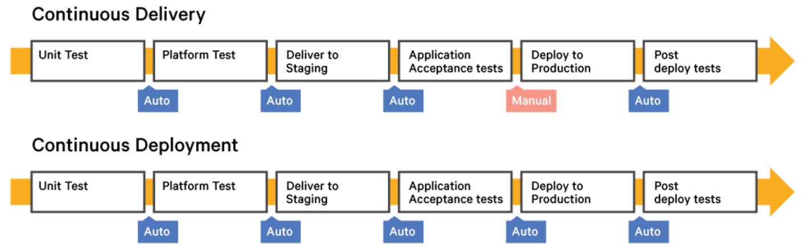
Next step of IaC is ….
…. Continuous deployment

Slide 4
CD Tools
AWS CodeDeploy
AWS CodePipeline
AWS CodeCommit

Slide 5
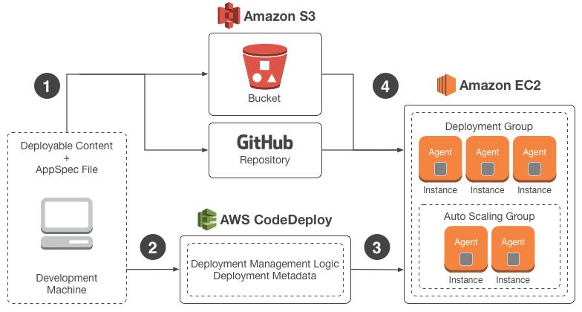
Code Deploy

Slide 6
Code Deploy
Create deployable content on your local development machine
Provide AWS CodeDeploy with information about your deployment, such as which Amazon S3 bucket or GitHub repository
AWS CodeDeploy agent on each instance polls AWS CodeDeploy to determine what and when to pull from the specified Amazon S3 bucket or GitHub repository
AWS CodeDeploy agent on each instance polls AWS CodeDeploy to determine what and when to pull from the specified Amazon S3 bucket or GitHub repository

Slide 7
Code Deploy Key Components
A name that uniquely identifies the application you want to deploy | Application:
A set of deployment rules and deployment success and failure conditions used by AWS CodeDeploy during a deployment | Deployment configuration:
A set of individual instances. A deployment group contains individually tagged instances | Deployment group:
An IAM role that you attach to your Amazon EC2 instances. This profile includes the permissions required to access the Amazon S3 buckets or GitHub repositories | IAM instance profile:

Slide 8
Code Deploy Key Components
An archive file containing source content—source code, web pages, executable files, and deployment scripts—along with an application specification file (AppSpec file). Revisions are stored in Amazon S3 buckets or GitHub repositories | Revision:
An IAM role that grants permissions to an AWS service so it can access AWS resources | Service role:
The most recent version of the application revision that you have uploaded to your repository and want to deploy to the instances in a deployment group | Target revision:

Slide 9
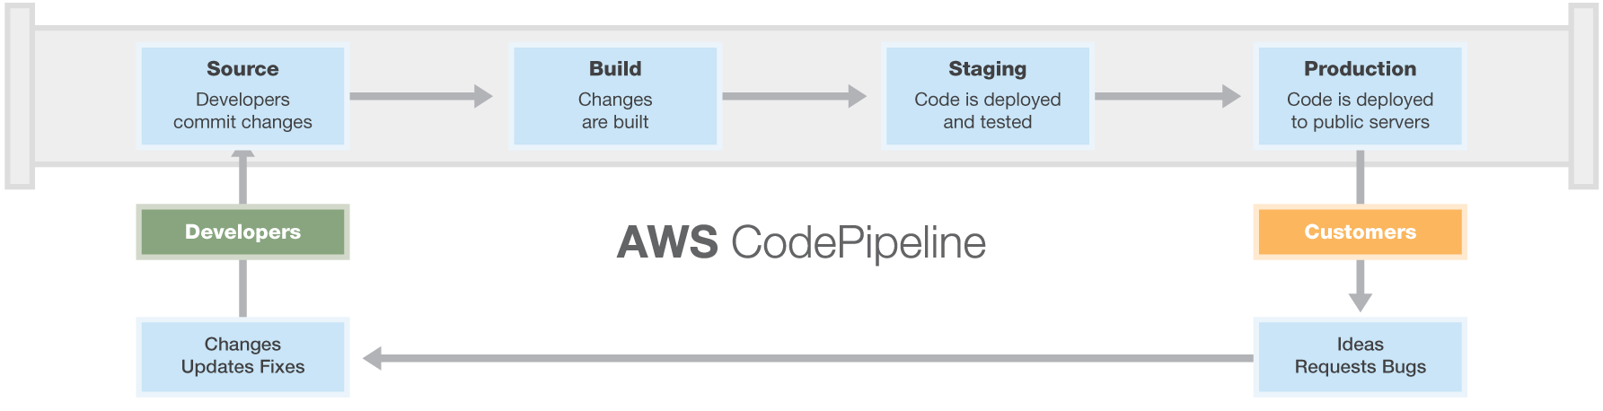
Code Pipeline

Slide 10
Code Pipeline Steps
Step 1: Setup Prerequisites
Step 2: Create a Pipeline in AWS CodePipeline
Step 3: Add Another Stage to Your Pipeline
Step 4: Clean Up Resources

Slide 11
Step 1
Prerequisites
Copy or Clone the Sample into a GitHub Repository
Create an IAM Role to Use for Jenkins Integration
Install and Configure Jenkins and the AWS CodePipeline Plugin for Jenkins

Slide 12
Step 2
Create a Pipeline in AWS CodePipeline
Sign in to the AWS Management Console and open the AWS CodePipeline console
In Step 1: Name,
in Pipeline name, type MySecondPipeline, and then choose Next step.
In Step 2: Source,
in Source provider, choose GitHub, and then choose Connect to GitHub.
In Step 3:
Build, choose Add Jenkins. In Provider name, type the name of the action you provided in the AWS CodePipeline Plugin for Jenkins (for example MyJenkinsProviderName).
In Step 4: Service Role,
from Role name, choose the service role you created for AWS CodePipeline
In Step 5: Review,
review the information, and then choose Create pipeline.

Slide 13
Step 3
Add Another Stage to Your Pipeline
Look Up the IP Address of an Instance
Create a Jenkins project for Testing the Deployment
Create a Fourth Stage

Slide 14
Step 4
Clean up resources
aws codepipeline delete-pipeline --name "MySecondPipeline"

Slide 15
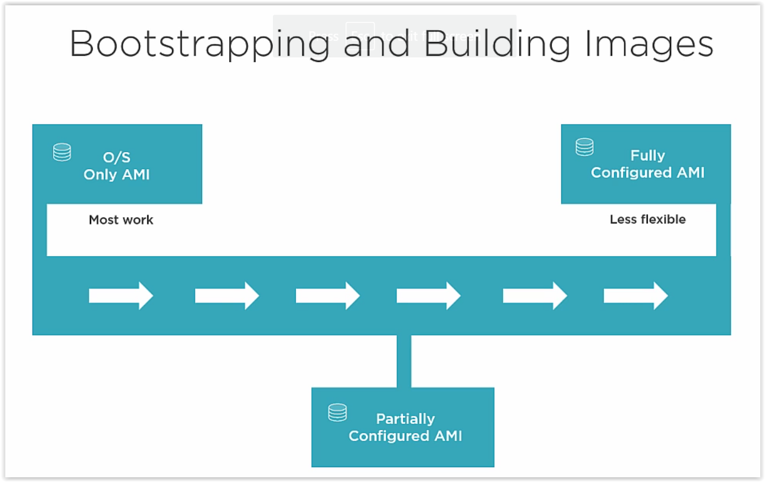
Bootstrap & Build Images

Slide 16
Blue Green Deployment
Blue-green deployment is a release technique that reduces downtime and risk by running two identical production environments called Blue and Green.
At any time, only one of the environments is live, with the live environment serving all production traffic.
For this example, Blue is currently live and Green is idle

Slide 17
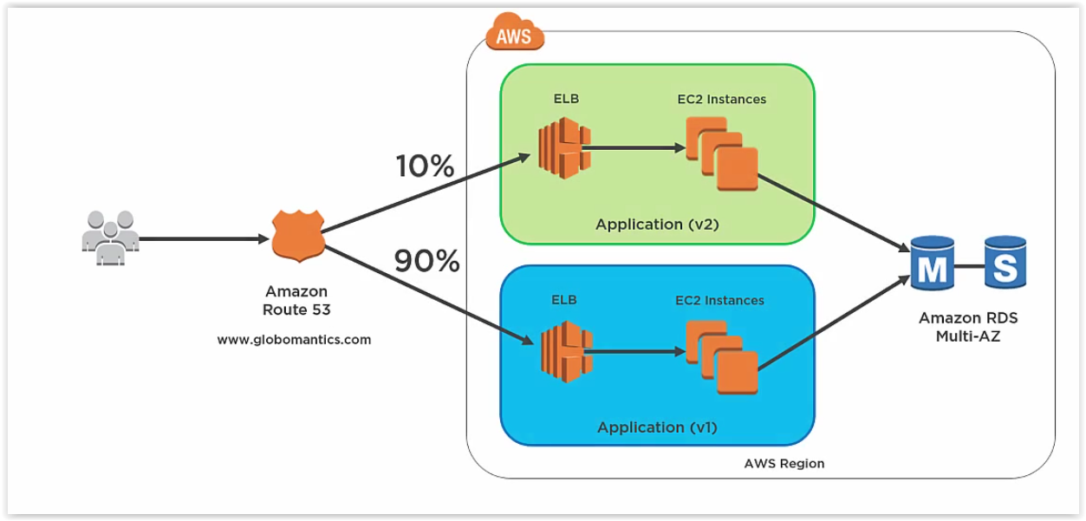
Blue Green Deploy

Slide 18
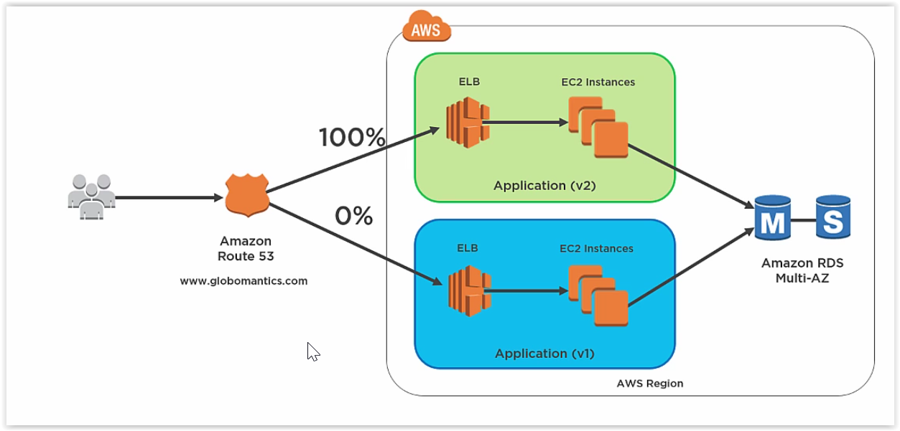
Blue Green Deployment

Slide 19
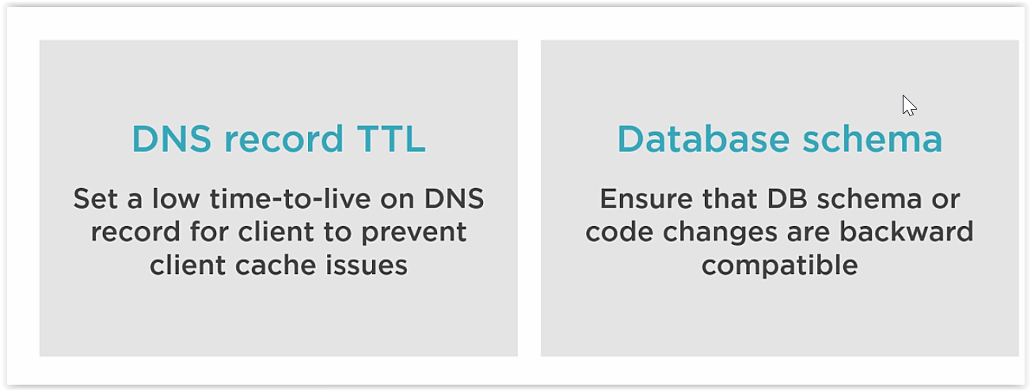
Blue Green Deployment Terms

